Slide 1
Error Correction

Slide 2
Error Correction
It can be handled in two ways:
receiver can have the sender retransmit the entire data unit.
The receiver can use an error-correcting code, which automatically corrects certain errors.

Slide 3
A frame consists of m data (i.e., message) bits and r redundant (i.e. check) bits.
Three different codes. They are all linear, systematic and block codes:
In a linear code, the r check bits are computed as a linear function of the m data bits. Exclusive OR (XOR) or modulo 2 addition is a popular choice. This means that encoding can be done with operations such as matrix multiplications or simple logic circuits.
In a systematic code, the m data bits are sent directly, along with the check bits, rather than being encoded themselves before they are sent.
In a block code, the r check bits are computed solely as a function of the m data bits with which they are associated, as though the m bits were looked up in a large table to find their corresponding r check bits.

Slide 4
Error-Correcting Codes
Four different error-correcting codes:
1. Hamming codes.
2. Binary convolutional codes.
3. Reed-Solomon codes.
4. Low-Density Parity Check codes.
All of these codes add redundancy to the information that is sent.

Slide 5
Single-bit error correction
To correct an error, the receiver reverses the value of the altered bit.
To do so, it must know which bit is in error.
Number of redundancy bits needed
Let data bits = m
Redundancy bits = r
∴Total message sent = m + r
The value of r must satisfy the following relation:
2^{r} ≥ m+r+1

Slide 6
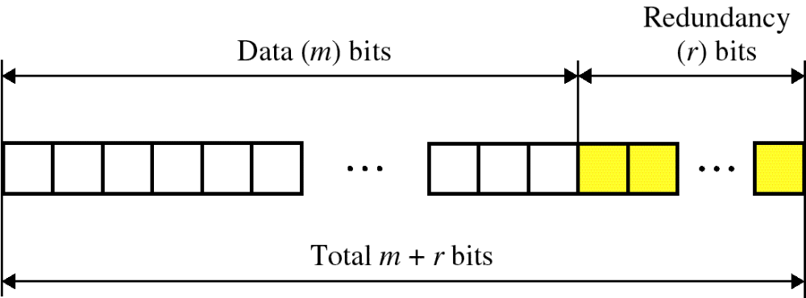
Error Correction

Slide 7
Hamming codes
In Hamming codes the bits of the codeword are numbered consecutively, starting with bit 1 at the left end, bit 2 to its immediate right, and so on.
The bits that are powers of 2 (1, 2, 4, 8, 16, etc.) are check bits.
The rest (3, 5, 6, 7, 9, etc.) are filled up with the m data bits.
Each check bit forces the modulo 2 sum, or parity, of some collection of bits, including itself, to be even (or odd).
A bit may be included in several check bit computations.
To see which check bits the data bit in position k contributes to, rewrite k as a sum of powers of 2.

Slide 8
For example, 11 = 1 + 2 + 8 and 29 = 1 + 4 + 8 + 16.
A bit is checked by just those check bits occurring in its expansion (e.g., bit 11 is checked by bits 1, 2, and 8). I
In the example, the check bits are computed for even parity sums for a message that is the ASCII letter ‘‘A.’’

Slide 9
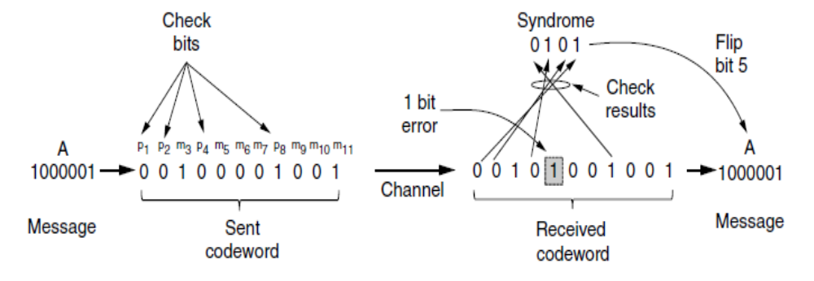
(11,7) Hamming code with 7 data bits and 4 check bits

Slide 10
If the check results are not all zero, however, an error has been detected. The set of check results forms the error syndrome that is used to pinpoint and correct the error.
In Fig, a single-bit error occurred on the channel so the check results are 0, 1, 0, and 1 for k = 8, 4, 2, and 1, respectively. This gives a syndrome of 0101 or 4 + 1=5.

Slide 11
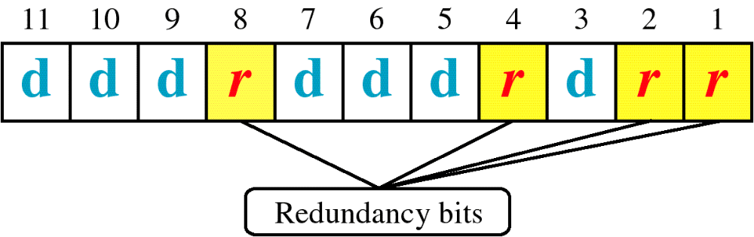
Hamming Code

Slide 12
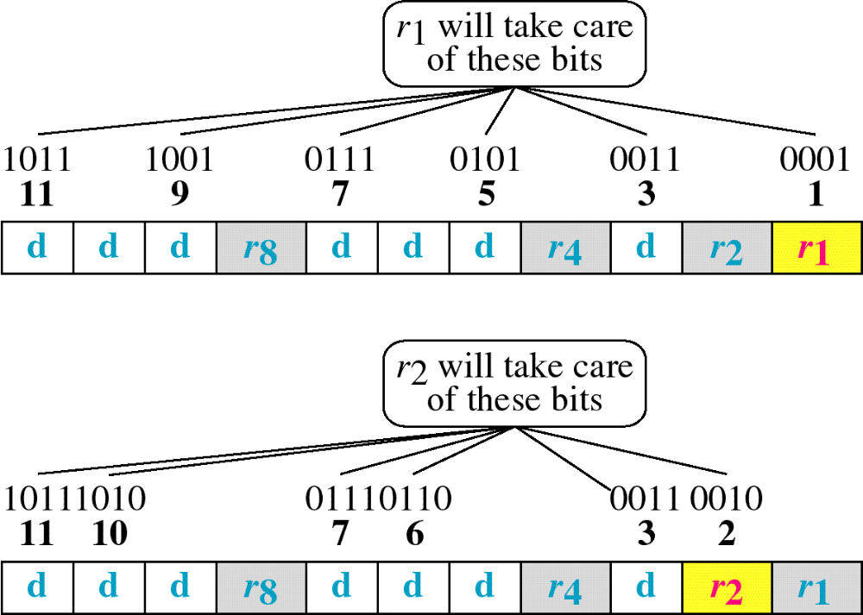
Hamming Code

Slide 13
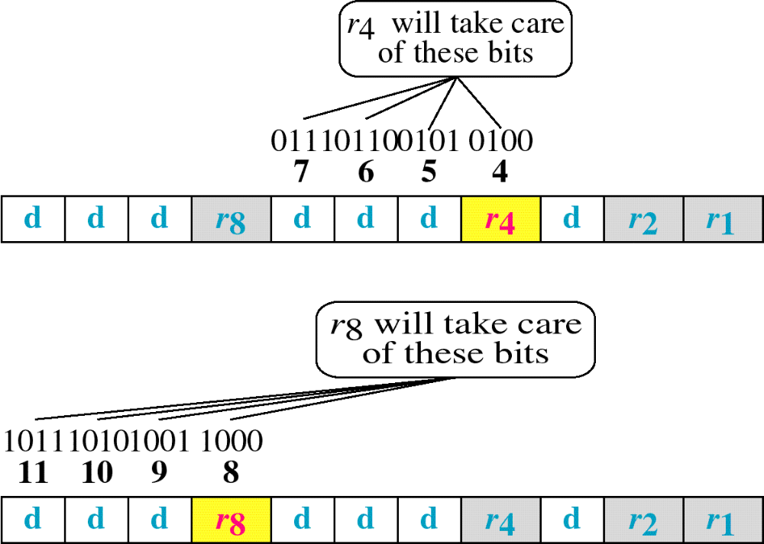
Hamming Code

Slide 14
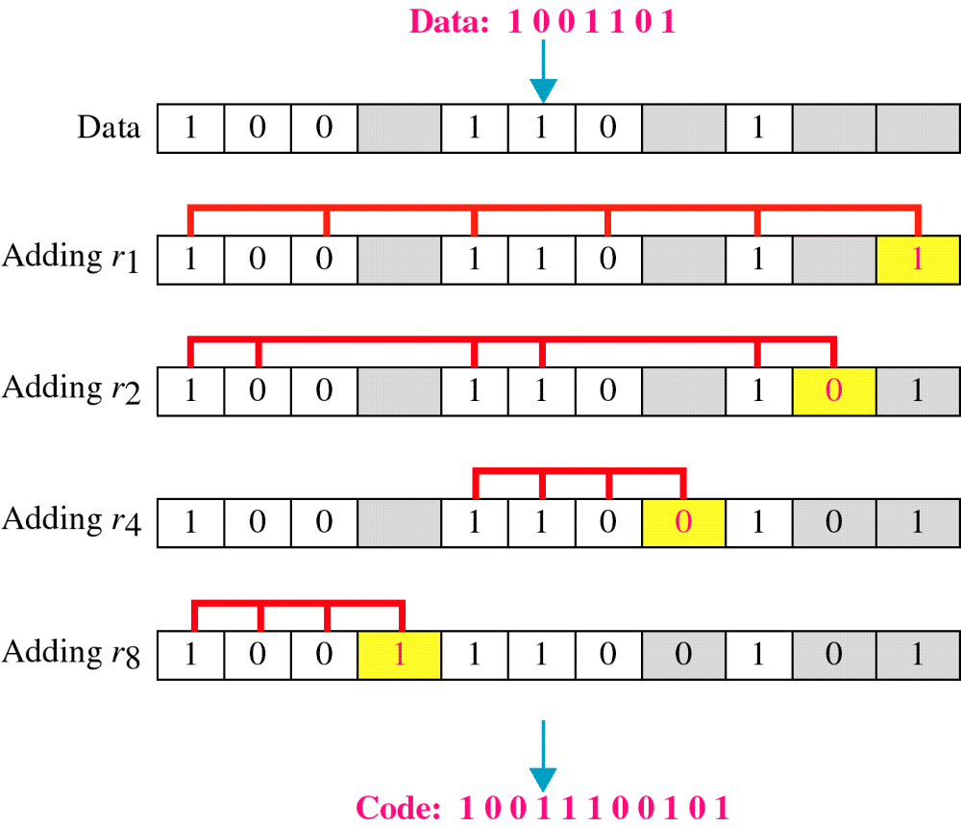
Example of Hamming Code
R1
Data values at 3, 5, 7, 9, 11 --- No. of ones – 3 To have even parity R1 should be 1
R2
Data values 3,6,7,10,11 ---- No. of ones – 4 To have even parity R2 should be 0
R4
Data Values 5, 6, 7 ---- No. of ones – 2 To have even parity R4 should be 0
R8
Data Values 9, 10 ,11 --- No. of ones – 1 To have even parity R8 = 1

Slide 15
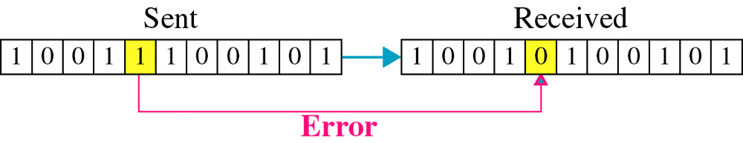
Single-bit error

Slide 16
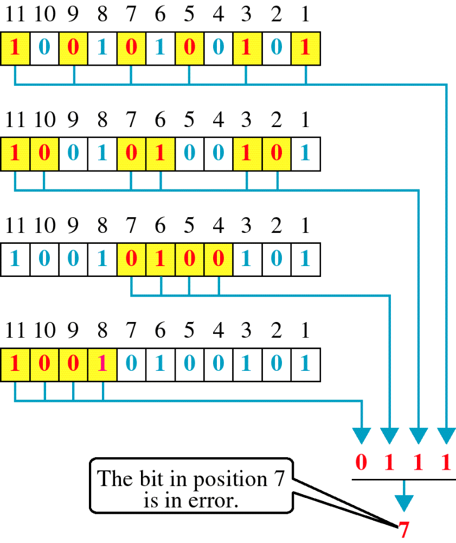
Error
Detection

Slide 17
Use of HD for error correction
To correct d single bit errors , we need an algorithm that creates a code list with HD at least 2d + 1.
For eg. Consider the following legal CWs:
0000000000, 0000011111,1111100000,1111111111
HD is 5 .. It can be used to correct 2 single bit errors

Slide 18
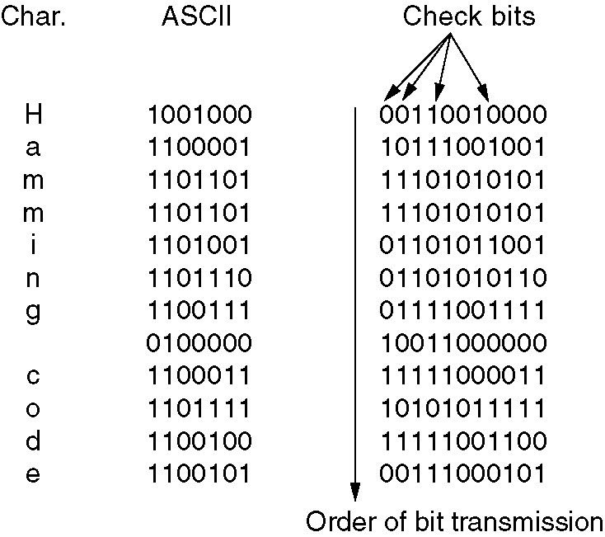
Hamming Code to correct burst errors

Slide 19
Convolutional code
This code is not a block code. In a convolutional code, an encoder processes a sequence of input bits and generates a sequence of output bits.
There is no natural message size or encoding boundary as in a block code.
The output depends on the current and previous input bits. That is, the encoder has memory.
The number of previous bits on which the output depends is called the constraint length of the code.
Convolutional codes are specified in terms of their rate and constraint length.

Slide 20
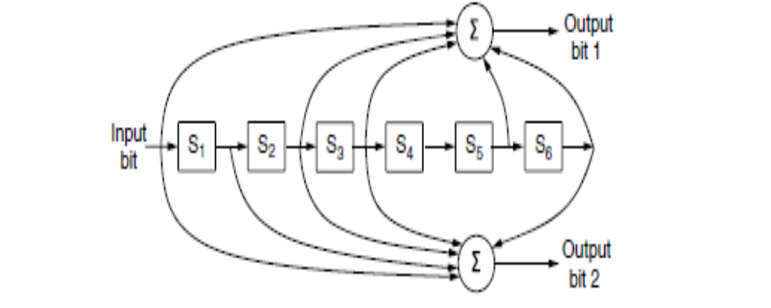
Convolutional codes are widely used in deployed networks, for example, as part of the GSM mobile phone system, in satellite communications, and in 802.11.
The NASA binary convolutional code used in 802.11.

Slide 21
This code is known as the NASA convolutional code of r = 1/2 and k = 7, since it was first used for the Voyager space missions starting in 1977. Since then it has been liberally reused, for example, as part of 802.11.
In Fig, each input bit on the left-hand side produces two output bits on the right-hand side that are XOR sums of the input and internal state. Since it deals with bits and performs linear operations, this is a binary, linear convolutional code. Since 1 input bit produces 2 output bits, the code rate is 1/2. It is not systematic since none of the output bits is simply the input bit.

Slide 22
The internal state is kept in six memory registers. Each time another bit is considered as input, the values in the registers are shifted to the right.
For example, if 111 is input and the initial state is all zeros, the internal state, written left to right, will become 100000, 110000, and 111000 after the first, second, and third bits have been input.
The output bits will be 11, followed by 10, and then 01. It takes seven shifts to flush an input completely so that it does not affect the output. The constraint length of this code is thus k = 7.

Slide 23
A convolutional code is decoded by finding the sequence of input bits that is most likely to have produced the observed sequence of output bits (which includes any errors).
For small values of k, this is done with a widely used algorithm developed by Viterbi (Forney, 1973).
The algorithm walks the observed sequence, keeping for each step and for each possible internal state the input sequence that would have produced the observed sequence with the fewest errors.
The input sequence requiring the fewest errors at the end is the most likely message.

Slide 24
Reed-Solomon code
Like Hamming codes, Reed-Solomon codes are linear block codes, and they are often systematic too.
Unlike Hamming codes, which operate on individual bits, Reed-Solomon codes operate on m bit symbols.
Reed-Solomon codes are based on the fact that every n degree polynomial is uniquely determined by n + 1 points.

Slide 25
For example, a line having the form ax + b is determined by two points.
Extra points on the same line are redundant, which is helpful for error correction.
Imagine that we have two data points that represent a line and we send those two data points plus two check points chosen to lie on the same line.
If one of the points is received in error, we can still recover the data points by fitting a line to the received points.
Three of the points will lie on the line, and one point, the one in error, will not. By finding the line we have corrected the error.

Slide 26
Reed-Solomon codes are actually defined as polynomials that operate over finite fields, but they work in a similar manner.
For m bit symbols, the codewords are 2m−1 symbols long.
A popular choice is to make m = 8 so that symbols are bytes. A codeword is then 255 bytes long.
The (255, 233) code is widely used; it adds 32 redundant symbols to 233 data symbols.

Slide 27
Decoding with error correction is done with an algorithm developed by Berlekamp and Massey that can efficiently perform the fitting task for moderate-length codes (Massey, 1969).
Reed-Solomon codes are widely used in practice because of their strong error-correction properties, particularly for burst errors.
They are used for Digital Subscriber Line (DSL), data over cable, satellite communications, and perhaps most ubiquitously on CDs, DVDs, and Blu-ray discs.
Because they are based on m bit symbols, a single-bit error and an m-bit burst error are both treated simply as one symbol error.
When 2t redundant symbols are added, a Reed-Solomon code is able to correct up to t errors in any of the transmitted symbols.

Slide 28
Reed-Solomon codes are often used in combination with other codes such as a convolutional code.
By adding a Reed-Solomon code within the convolutional code, the Reed-Solomon decoding can mop up the error bursts, a task at which it is very good. The overall code then provides good protection against both single and burst errors.

Slide 29
Low-Density Parity Check (LDPC) code.
LDPC codes are linear block codes that were invented by Robert Gallagher in his doctoral thesis (Gallagher, 1962).
In an LDPC code, each output bit is formed from only a fraction of the input bits.
This leads to a matrix representation of the code that has a low density of 1s, hence the name for the code.
The received codewords are decoded with an approximation algorithm that iteratively improves on a best fit of the received data to a legal codeword. This corrects errors.
LDPC codes are practical for large block sizes and have excellent error-correction abilities that outperform many other codes in practice. For this reason they are rapidly being included in new protocols.

